Slide 1


ITE-7101: COMPUTER PROGRAMMING
Course Project Video Presentation
Presented By: Ramon Villamangca

Slide 2


Presentation Outline
Part 1 | C++ Topical Presentation
Loops in C++
Data Types and Dimensions
Introduction to Functions & Procedures
Prerequisite Topics to Part 2
Part 2 | Solution to Programming Exercise

Slide 3
Part 1: Topical Presentation
1. Loops in C++
Loops is programming flow control mechanism that allows a code block to be executed repeatedly, in the process called “iteration”.
Types of C++ Loops
C++ provides for both imperative and functional constructs of looping:
Imperative Loops:
Imperative For Loop
While Loop
Do-While Loop
Functional Loops:
Range-based For Loop
For-Each Loop

Slide 4
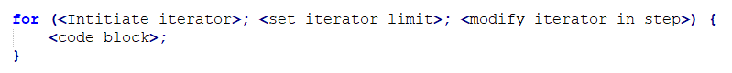
Part 1: Topical Presentation
1. Loops in C++
Imperative For Loop
Imperative For Loop is type of looping in which the number of iteration is clearly mentioned before the start of iteration. The code syntax is as follows:
For loops starts with the keyword “for” followed by the following inside parenthesis: the initial value of the iterator, a conditional statement stating the limit of iteration and the modification to be made to the iterator in each step of the iteration. This is then followed the code block (loop body) intended to be repeated, enclosed in curly braces. An example will make this clearer.

Slide 5
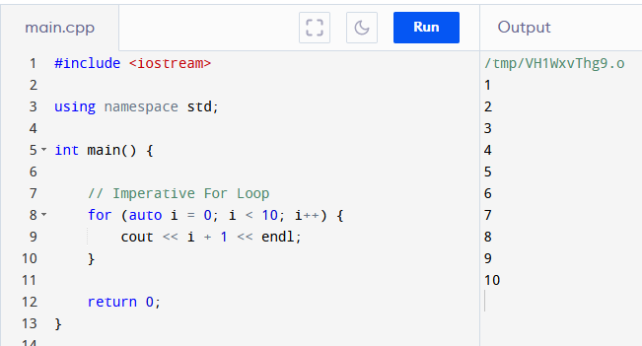
Part 1: Topical Presentation
1. Loops in C++
Imperative For Loop (Example)

Slide 6

Part 1: Topical Presentation
1. Loops in C++
While Loop
While Loop is type of looping in which the loop body will only be executed “while” certain condition is still met. The code syntax is as follows:
While loops starts with the keyword “while” followed by the condition to “continue” inside parenthesis followed by the code block (loop body) intended to be repeated, enclosed in curly braces. It can also support iteration but the iterator must be declare before the start of the while-block. An example will make this clearer.

Slide 7
Part 1: Topical Presentation
1. Loops in C++
While Loop
While Loop is type of looping in which the loop body will only be executed “while” certain condition is still met. The code syntax is as follows:
While loops starts with the keyword “while”, followed by the condition to “continue” inside parenthesis followed by the code block (loop body) intended to be repeated, enclosed in curly braces. It can also support iteration but the iterator must be declare before the start of the while-block. An example will make this clearer.

Slide 8
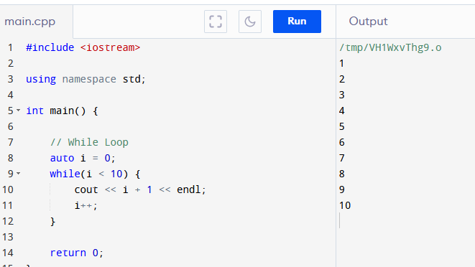
Part 1: Topical Presentation
1. Loops in C++
While Loop (Example)

Slide 9
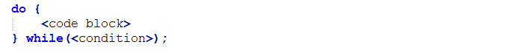
Part 1: Topical Presentation
1. Loops in C++
Do-While Loop
Do-While Loop is variation of the While Loop wherein the conditional statement is at the end of the code block. The code syntax is as follows:
Do-While loops starts with the keyword “do”, followed by the code block (loop body) intended to be repeated, enclosed in curly braces, followed by the “while” condition to “continue” inside parenthesis. Note that the “while” condition needs to be needs to be terminated by a semi-colon (;). Having the loop body in front of the condition, ensures that the body will execute at least once. An example will make this clearer.

Slide 10
Thank YOU!!!

Slide 11
Part 1: Topical Presentation
1. Loops in C++
Do-While Loop (Example)

Slide 12
Part 1: Topical Presentation
1. Loops in C++
Scope and Variable Lifetime
A local variable is only valid in the code block it resides on. The validity of a local variable within a code blocks is called its scope. We also say that the local variable has a lifetime only up to it gets out of scope.
Since the loops we learned so far are essentially code blocks, we need to know that variables created inside a loop, lose their scope when the loop ends.
This is the reason why While-Loops are not recommended to do iteration as the iterator has to be declared outside the loop’s code block. That means the iterator memory allocation is not released when it gets out of scope.

Slide 13
Part 1: Topical Presentation
1. Loops in C++
Infinite Loop
Loops rely on conditions and limits in order in order to terminate. A well-designed loop should terminate gracefully when the conditions are met. This is not always the case, though. Sometimes we may

